Slide 1

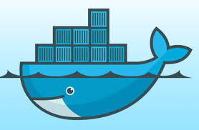






Unit Testing
Quality Check
Web Application
Database
Github Repository
Jenkins Pipeline
Docker Containers
Docker Containers
AWS EC2 Instance A
AWS EC2 Instance B

